Slide 1
Software Policy
Michael Divis
CS-405-T6651

Slide 2
Defense in depth
Defense in depth is something that is a common practice when trying to protect programming and code.
Being able to write code and figure out what vulnerabilities are there and what ones to watch out for are important.
C++ can be a high risk high reward language. There is a lot that can be done with it and there are a lot of ways that it can be manipulated in the wrong way.
Being able to fully defend C++ code is a skill in itself and can be very difficult to think about in the moment of coding.

Slide 3
Defenses
Writing code, it is better to think of the possible vulnerabilities during the time of coding.
There are many ways of exploiting C++, some of which being SQL injection and buffer overflow.
SQL injection can pull data that shouldn't be able to pulled in order to gain access to private data and information.
Buffer overflow can be exploited in a way that the hacker is able to grab a lot of hidden information and be able to manipulate the code at hand to give them the information that they need.

Slide 4
Principles
Keep it simple, stupid: This means you should be writing code as simple as possible. One of the rules of basic programming is to never get caught up in trying to be overly clever or showing off with a thick block of advanced code.
Dry coding: The Don't Repeat Yourself (DRY) computer programming principle means, plainly, not repeating code. It's a common coding mistake. When writing code, avoid duplication of data or logic.
Open/Closed: You could release a version for coders to directly modify and integrate your released code. What happens when you release a major update four months later, though?
Their code will break. This will likely make your cohorts very unhappy. They won't want to use your library for much longer, no matter how helpful it may have been in its heyday.

Slide 5
Composition Over Inheritance: Theyeritance causes two major issues. First, the inheritance hierarchy can get messy in a hurry. You also have less flexibility for defining special-case behaviors.
Single Responsibility: The single responsibility principle states that every class or module in a program should only provide one specific functionality. As Robert C. Martin puts it, "A class should have only one reason to change."
Separation of Concerns: The separation of concerns concept is an abstract version of the single responsibility principle. This idea states that a program should be designed with different containers, and these containers should not have access to each other.
A well-known example of this is the model-view-controller (MVC) design.

Slide 6
Prinicples
You Aren't Going to Need It (YAGNI): This principle means you should never code for functionality on the off chance that you may need something in the future. One of the most important principles of computer programming to learn is that you shouldn't try to solve a problem that doesn't exist.
Document Your Code: With all of this talk of the principles of coding, it can be easy to forget about the human on the other side who may eventually be getting into your code themselves. The senior developer will stress the importance of documenting your code with proper comments.

Slide 7
Principles
Refactor: It's hard to accept, but your code isn't going to be perfect the first time. Refactoring code means reviewing your code and looking for ways to optimize it, making it more efficient while keeping the results exactly the same.
Clean Code At All Costs: Leave your ego at the door and forget about writing clever code. When we say this, we mean the kind of code that looks more like a riddle than a solution. You're not coding to impress strangers. You're in this profession to solve problems.

Slide 8
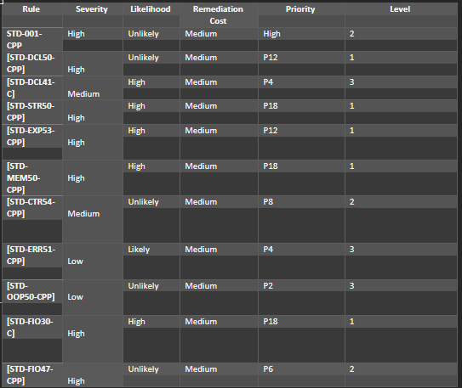
Coding Standards

Slide 9
Coding Standards
The bets practice is to follow coding standards and to make sure the code is acceptable and usable.
Following a standard will help to make sure the code is clean and safe from errors before any unit testing or help in the code itself.

Slide 10
Encryption Strategy
In this case I feel like combining two might be the best method.
Combining encryption in use and encryption at rest would be helpful because not matter what is going on with the data it will be secured.
Having secure data is one of the most important parts of writing a program and keeping the user's personal information safe from public use and views.

Slide 11
Triple-A Framework
It is important to implement the Triple-A framework because it will make people feel more secure storing their data.
Authenticate, Authorize and Accounting are all important to make sure the user accessing the data is the right person and that they are who they say they are.
This rule will allow users to feel more comfortable saving their emails and signing up for the page because it does take a lot to use.

Slide 12
Unit-Testing
Unit testing is helpful because it can help the programmer to make sure there are no mistakes.
This software is very powerful and can make coding a big project a little safer and more secure by making sure the unit tests are being used the right way and not just being overlooked.
Having unit tests laid out in a good order of learning your vehicle and or code language to help better some of those skills.

Slide 13
Risks and Benefits
If you decide to wait with testing it can be drastically bad for your coding. Leaving testing to the end or adding security to the end is bad practice and should not be the way anyone does it.
Leaving things to the end will make going back through to make sure everything is okay will be a mission in itself.
Being able to think or the defenses needed during coding will help a lot to not only cut back time but it will help you write cleaner and more effective coding.
Having everything setup with its own little test is so helpful because at that point the programmer can already make changes about how the program is rana nd how the functions or data should be passed around.

Slide 14
Recommendations
In this security policy it doesn’t go over the fact of certain ways to create methods or anything of that sort, if they should b e public or private.
It also doesn’t show anything about how to use the code or anything in that sort of field where a lot of products will have a big mapper where everything gets miscommunicated and forgotten.
Being prepared for any scenario is very hard and very difficult.

Slide 15
Conclusion
Making sure the coding standards are followed and the principles are met the right way.
It is important to make sure the code created is able to make the user feel safe operating it.
Defense in depth and triple-A security are both equally important and they should be handled and understood fully when creating a program.

